Slide 2
The Era of Digital Marketing & Ethical Use of Social Media
Dr. Prasanna Venkatesh

Slide 3
The Era of Digital Marketing
Digital Marketing - 1990
Unaware on the uses of digital marketing
They were not sure whether their strategies would work

Slide 4
COVID 19 and the Digital Space
Telemedicine
Online Pharma
Online Diagnostics
Online Home Care

Slide 5
COVID 19 and the Digital Space
Online Portals Patient Feedback

Slide 6
COVID 19 and the Digital Space
Digital Reputation

Slide 7
Key Milestones in Digital Marketing
1990
The term Digital Marketing was first used
1993
The first clickable web-ad banner went live
1998
Birth of Google / MSN and Yahoo launches
Web Search
2002
LinkedIn

Slide 8
2004
Gmail.com & Facebook goes live
2005
YouTube
2010
WhatsApp
2015
The rise of predictive analytics, wearable techs and
Content Marketing

Slide 9
Analytical Insights
77% of patients use search
26% reviews generated by consumers
50% used health information sites
54% of the patients used health insurance company sites
83% used hospital websites
Search drives nearly 3 times as many visitors to hospital sites as compared to the number of visitors from other affiliate/referral sites

Slide 10
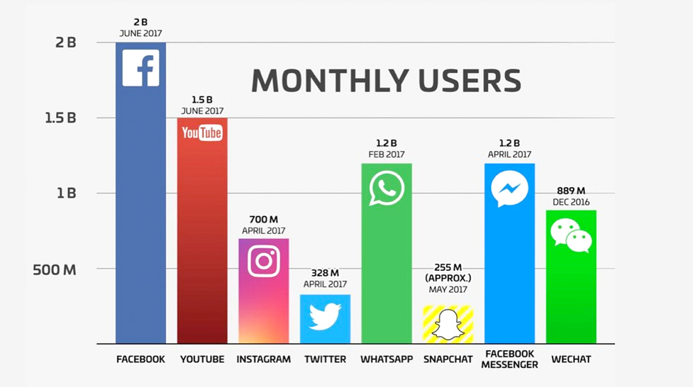
Interesting Stats on SMP

Slide 11
Digital AD spends vs Traditional

Slide 12
Key Elements of Digital Marketing
Digital Marketing
Search Engine Optimization
(SEO)
Search Engine Marketing
PPC/Google Ads
Social Media Marketing

Slide 13
Search Engine Optimization (SEO)
SEO is a process of optimizing your website to get organic, or un-paid, traffic from the search engine results page
In order to do this, search engines will scan, or crawl, different websites to better understand what the site is about

Slide 14
Key Features of SEO
Better User Experience
Primary Source of Leads
Results to Higher Conversion Rate
Builds Brand Credibility
Helps Establish Brand Awareness

Slide 15
Search Engine Marketing
SEM (Search Engine Marketing) is the process of gaining website traffic by purchasing ads on search engines

Slide 16
Key Features of SEM
Increase brand awareness and brand equity of product
Increase Visibility
Advertise to an audience that's already interested in you
Increase in targeted leads
Target your ads to users based on languages and locations

Slide 17
Social Media Marketing
Social media marketing is the use of social media platforms to connect with your audience to build your brand, increase sales, and drive website traffic
The major social media are Facebook, Instagram, Twitter, LinkedIn, Pinterest, YouTube, and Snapchat

Slide 18
Key Features of Social Media Marketing
Social media encourages contributions and feedback from everyone
Social media is a two-way communication channel
Reliability
Build communities & Customer service
Avoid spamming

Slide 19
Primary focus areas for Hospitals in Digital Marketing

Slide 20
Invest in content marketing
Make sure your website is mobile responsive
Use video marketing to attract new patients and healthcare customers

Slide 21
Invest in multichannel initiatives and customer touch-points
Invest on your online reputation
Use social media like a pro for your healthcare marketing campaigns

Slide 22
Are you ready for Digital??
Research your competition
Understand security, compliance and regulations
Define your goals and develop a plan to reach them
Research Keywords and develop an SEO strategy

Slide 23
Create and optimize thoughtful content
Make sure your website is responsive
Track and analyze results
Monitor consistently and improve accordingly

Slide 24
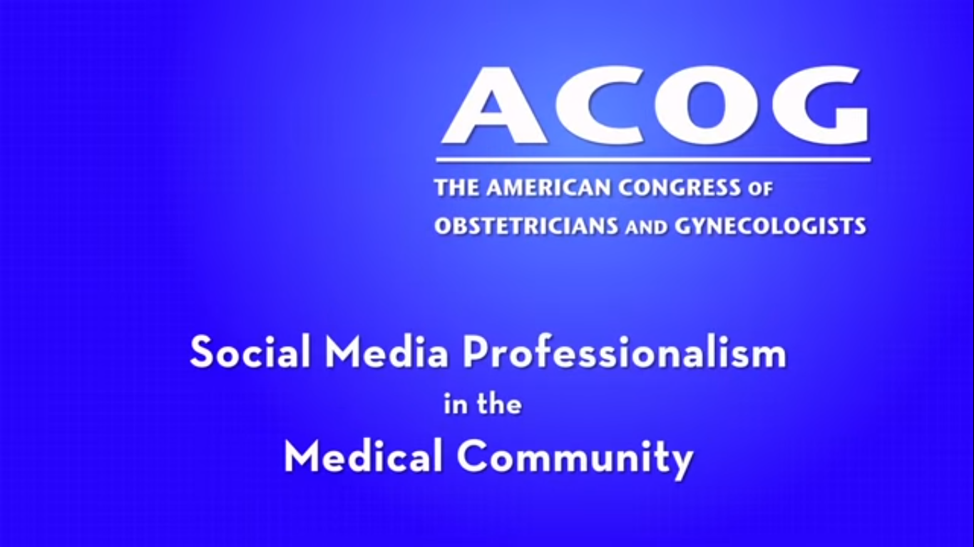

Slide 25
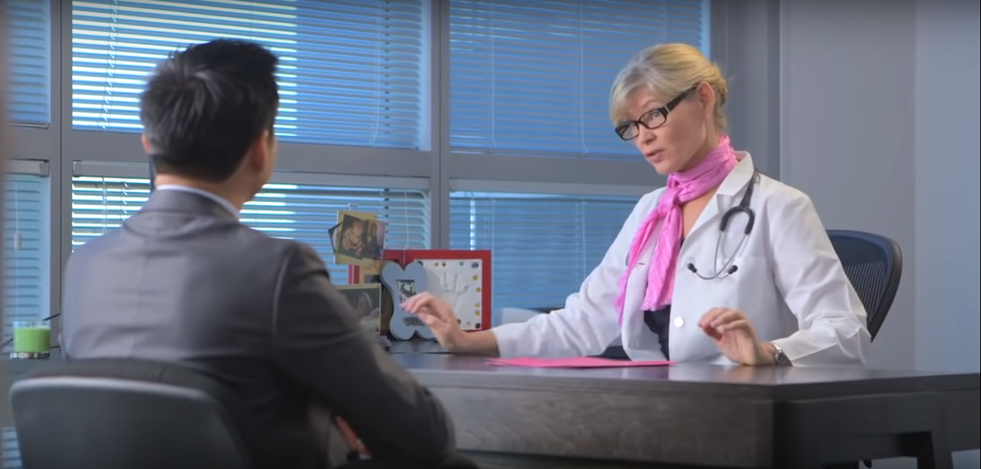

Slide 26
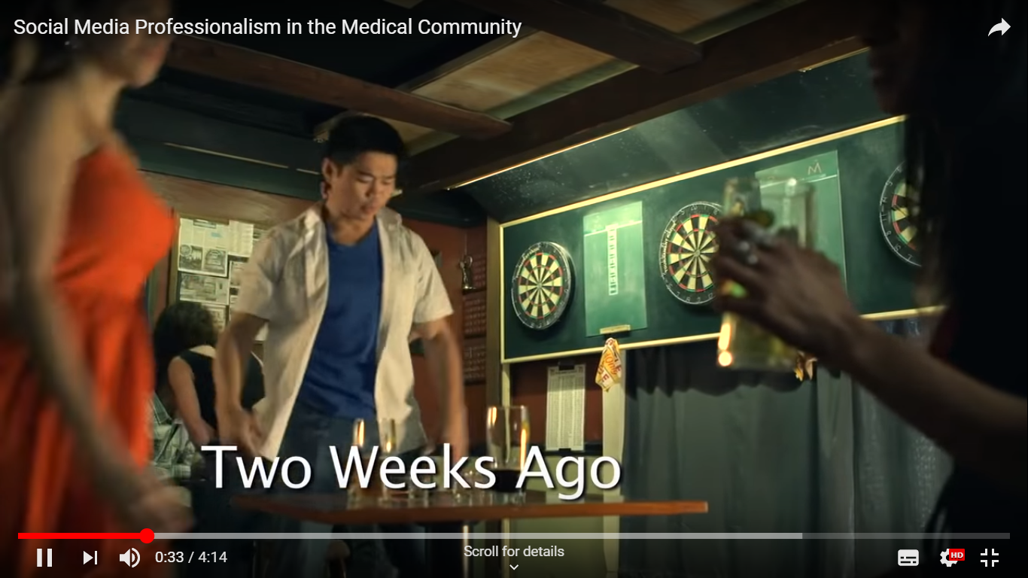

Slide 27
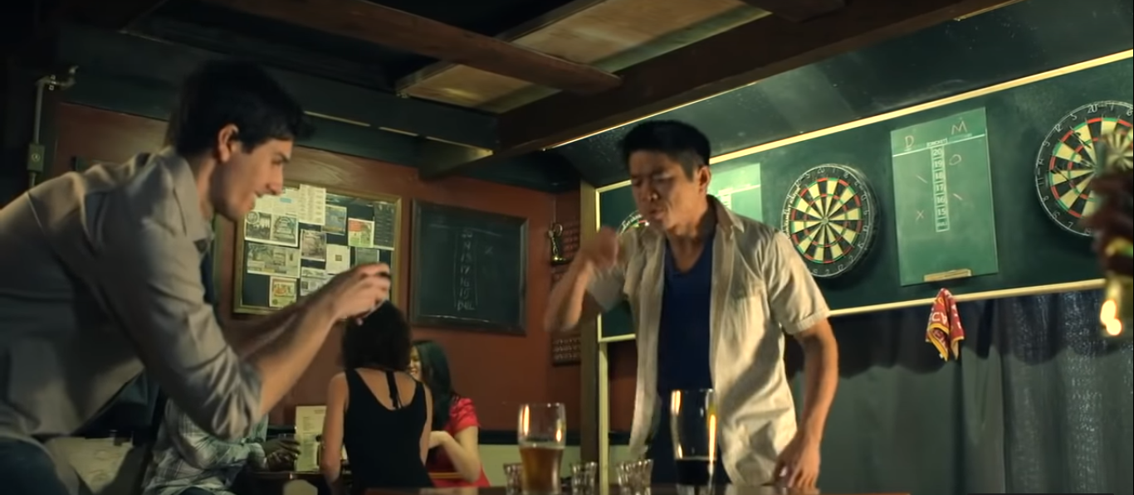

Slide 28
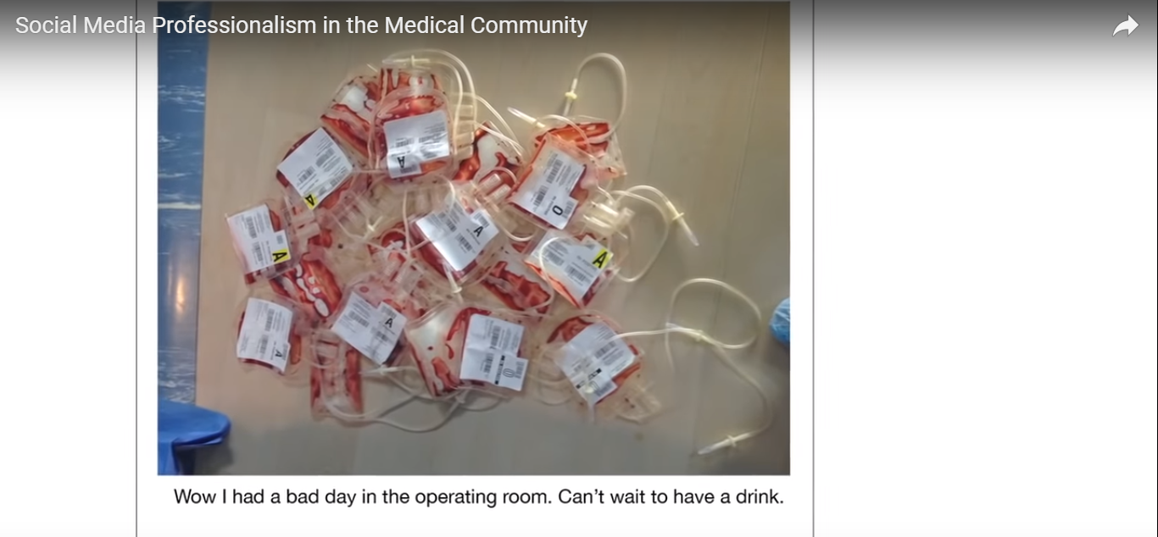

Slide 29
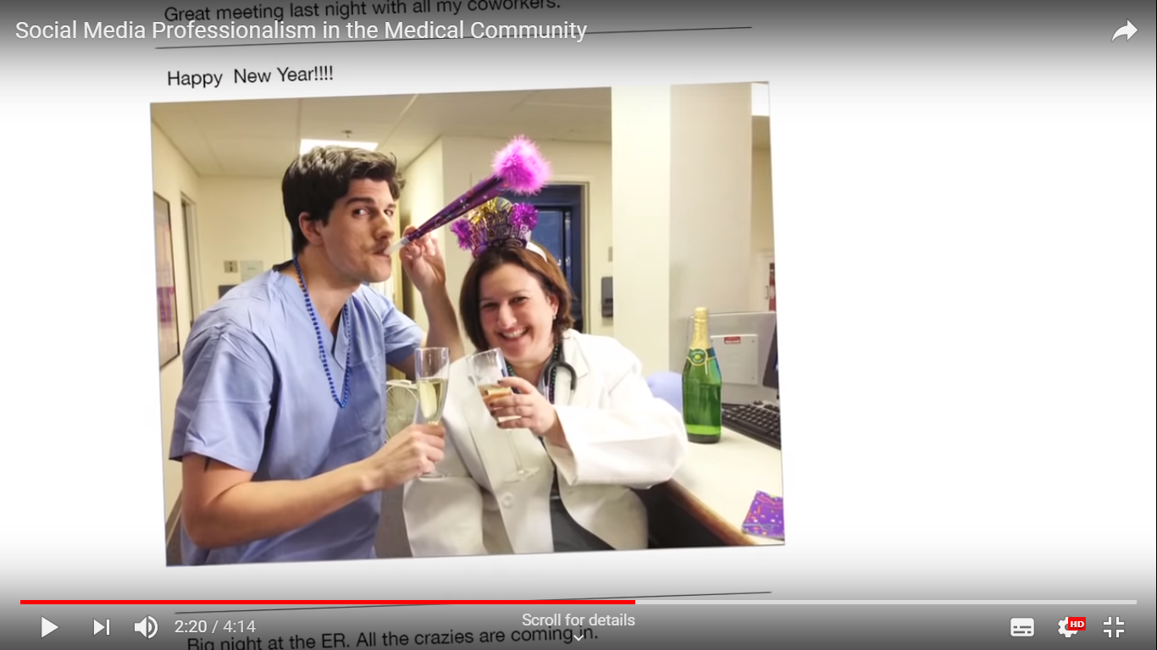

Slide 30
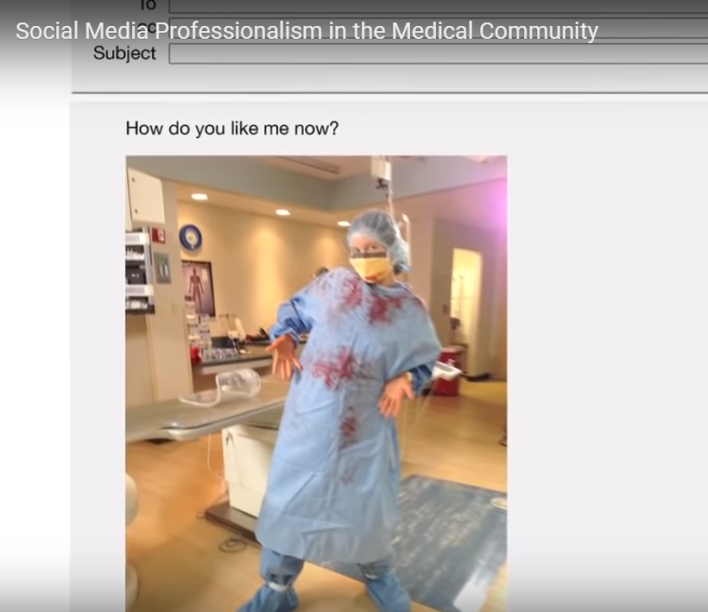

Slide 31
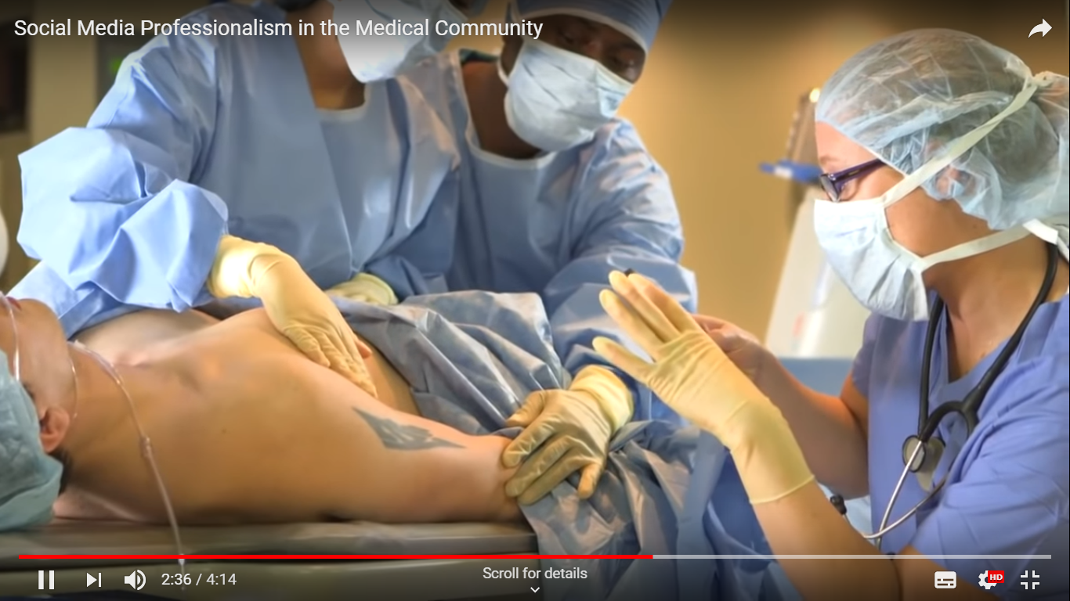

Slide 32
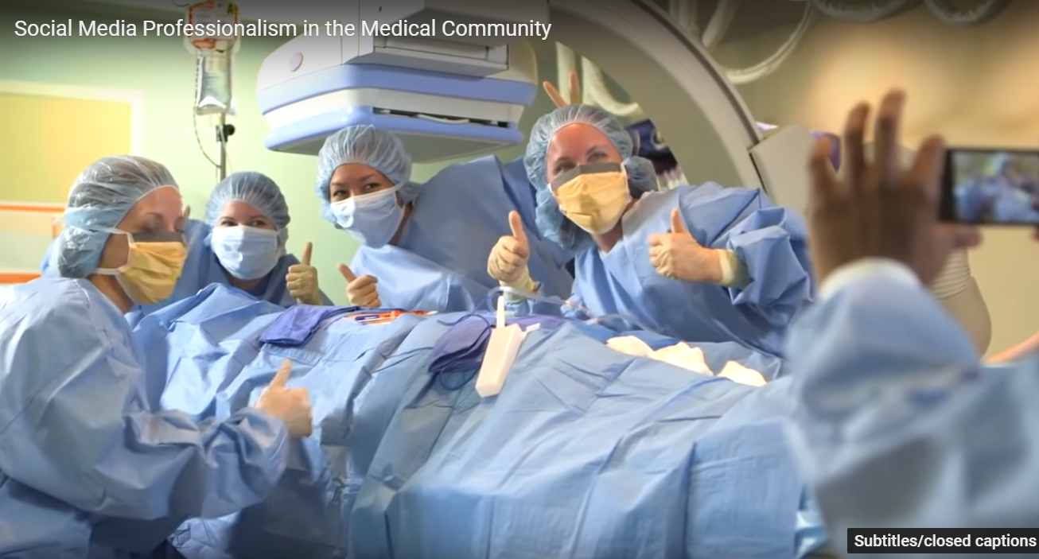

Slide 33
What we should not do?
Promote an Individual Doctor
Claim to be the best
Offer 100% guarantee
Money-back / Cash Back
Endorse a commercial product
Befriend a Patient Online

Slide 34
What we can do?
Disease awareness
Preventive measures that can be taken
Patient Education
Targeted Patient Counselling after Diagnosis
Surgeons' online persona & Professional representation
Follow Institutional Protocol

Slide 35
Thank You www.nuhospitals.com

